Slide 1
Week-5 Team Presentation
Team Name: Gladiators
Team Members: Shivani Asokumar, Akash Narang, Mit Jain, Juhi Malkani
Team Lead: Juhi Malkani

Slide 2

PROJECT: E-COMMERCE WEBSITE
Description: A website where users can buy/sell products
Features:
Product to
be sold:
Shopping Cart/Wishlist
Home page / Featured products page
Individual Product Page
Payment module
Authentication for buyers and sellers
Filtering based on products
User Management
Seller Module

Slide 3
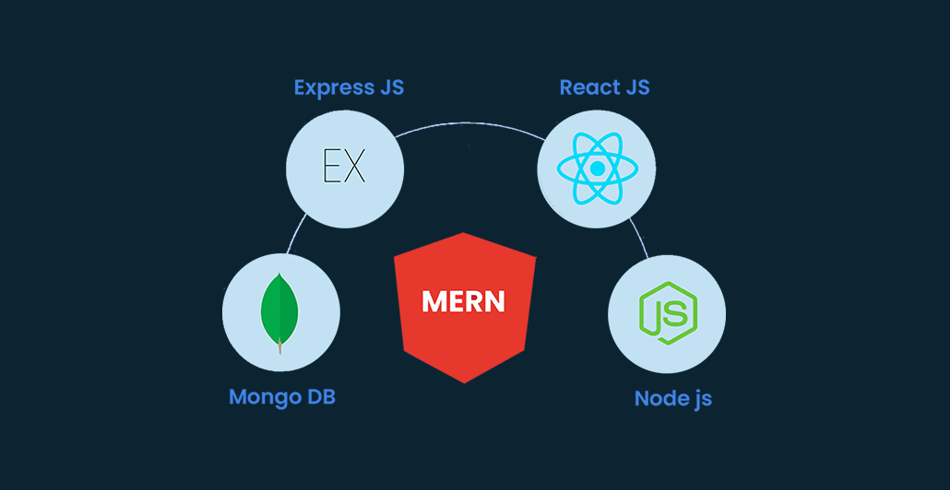

Technologies used

Slide 4
MILESTONES FOR CURRENT WEEK
Integrate API to create product card component
Finish the product listing page
Work on seller page (insert products into DB)
Soft milestone: Host frontend on AWS
Frontend
Finish Product Listing page API
Implement adding a new product into DB for a seller
Implement deleting a product
Implement Wishlist API
Backend

Slide 5
What’s been accomplished so far this week
Working on the seller page
Working on the product card component using dummy data
Working on individual product page
Frontend
Finished adding a new product for a given seller
Finished data modeling of products
Backend

Slide 6
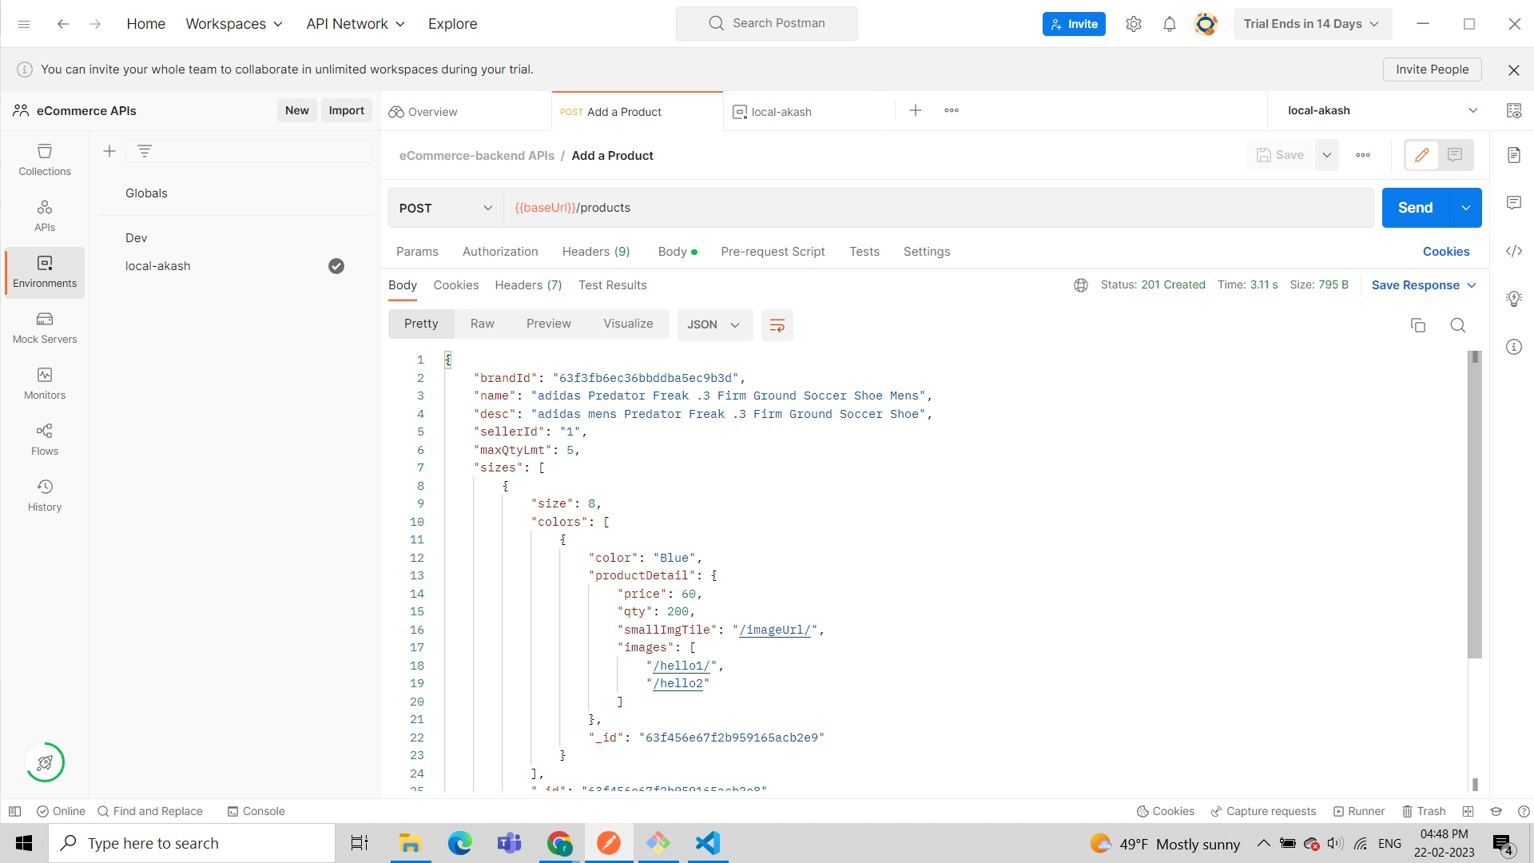
Add a product Using Postman

Slide 7
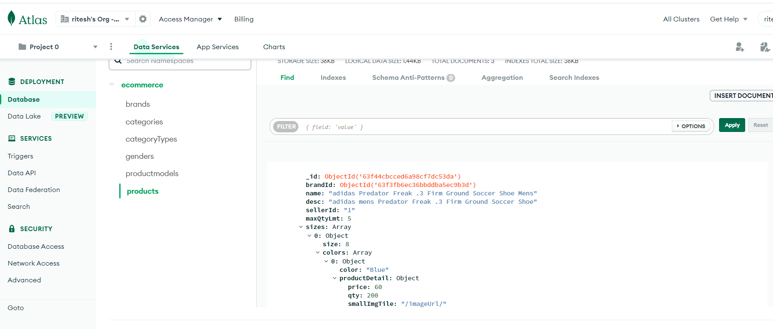
Mongo Db Collections AND entry of product

Slide 8

Job assignments for week 5
Work on the seller page.
Create the product listing page from templates based on product card component
Host the frontend code to the AWS EC2.
Juhi
Shivani
Work on the product listing page
Work on individual products page
Mit
Finish product listing page API
Implement wishlist API
Akash
Finish product listing page API
Implement individual product page API

Slide 9
App user documentation
New Users
Create an account
Returning users
Login to your account
Navigate to HOME, MEN or WOMEN. Select a product and add to cart.
Add product to cart
Make a purchase/View shopping cart
Click on Shopping Cart icon on top right corner of website
Delete any products or edit quantity
Continue to checkout
Seller: Add a product to be sold
Follow the instructions on the form and fill out the information
Add product to the website

Slide 10
Use cases
Log In / Sign Up
Sellers can add products to the website
Users can add/delete products to their shopping cart
Users can checkout products
Users can view their order summary
Users can filter products based on gender/occasion

Slide 11
Expert User Documentation
Download VS code (to see code)
Install react
Install postman (for backend)
Run git clone https://github.com/mitrjain/eCommerce
Go to frontend or backend -> Run ‘npm ci’ -> Run ‘npm start’
Navigate to ‘http://localhost:3000/’ to view the website

Slide 12
Expert user feedback
Documentation is clear and easy to understand, with description of how the backend works
Website is pretty intuitive for the majority of users who browse the web
The aesthetic of the website can be more catered to the Shoe/Sneaker demographic

Slide 13
Use cases Feedback
It would be useful if the website can keep track of orders that customers made and have a list of orders in the seller dashboard with shipping information

Slide 14
Thank You!

